Slide 1
Bray Team Project Update
Avery Haynes, Locke Lehmann, Travis Carlson, Cody Sims, Zachary Walker, Michael Hager
9/22/2023

Slide 2
Current/Upcoming Tasks
Research Topics/Deliverables:
Brainstorming ideas for detecting true valve position/torque
Function Chain
Review SolidWorks parts and assemblies (are there more to send?)
Narrow down concepts

Slide 3
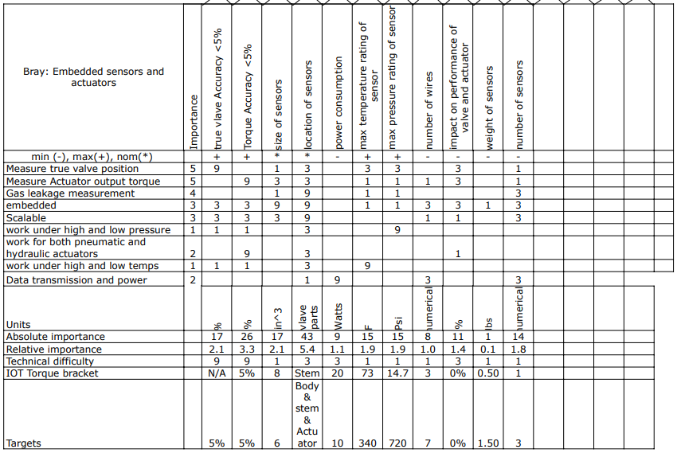
House of Quality
Is this helpful?
Maybe for narrowing down concepts and seeing if they fit the criteria

Slide 4
Black Box Model
Mechanical and Electrical Energy
Electrical Energy
Sense true valve Position
Data

Slide 5
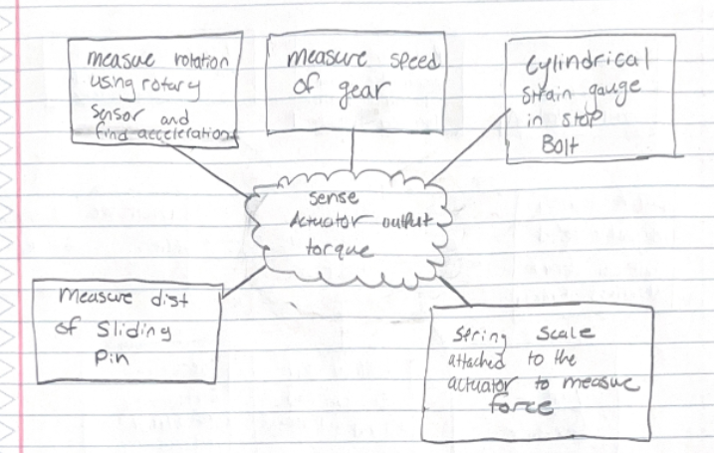
Brainstorming
Actuator output torque deliverable

Slide 6
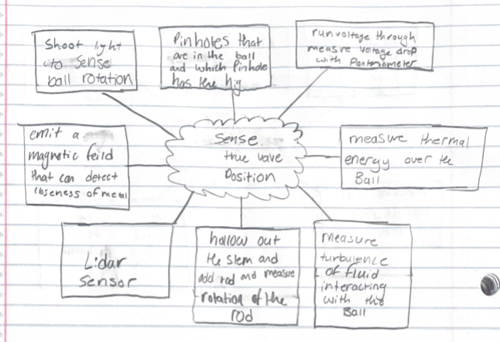
Brainstorming
True valve position deliverable

Slide 7
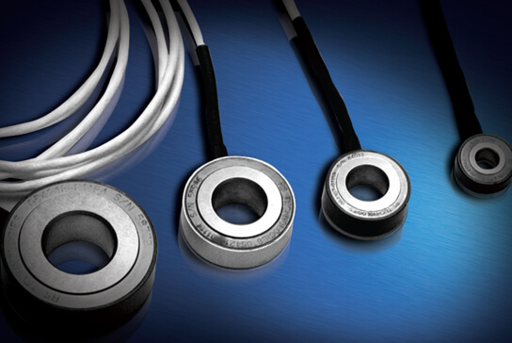
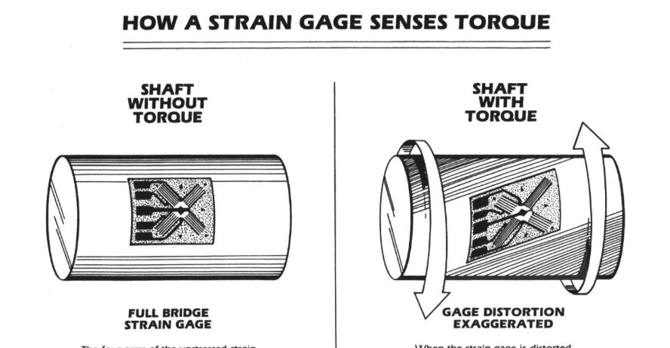
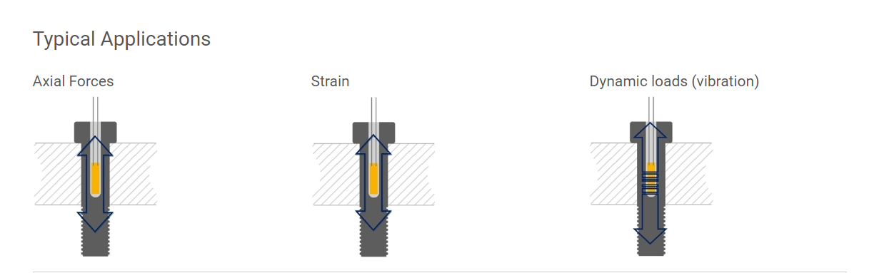
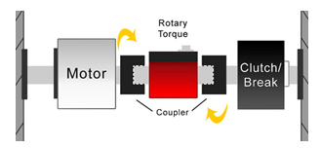
Strain Gauges
Full Bridge Gauge configuration to sense torque:
Measures shaft torsion
Could be attached to any stationary part against the stop bars that receives a torque
Washer Strain Gauges:
Used in place of a washer in a fastener assembly
Measures axial loads
Placed inline with stop bars
Cylindrical Strain Gauges:
Placed inside a fixed fastener
Measures axial loads, not torsional
Could be placed on a stop bar. (inside the rotating shaft?)
Rotational Torque Sensor:
Direct torque measurement
Rotary transducer & slip ring mounted in-line with shaft
Mounted between actuator and valve stem

